Slide 1
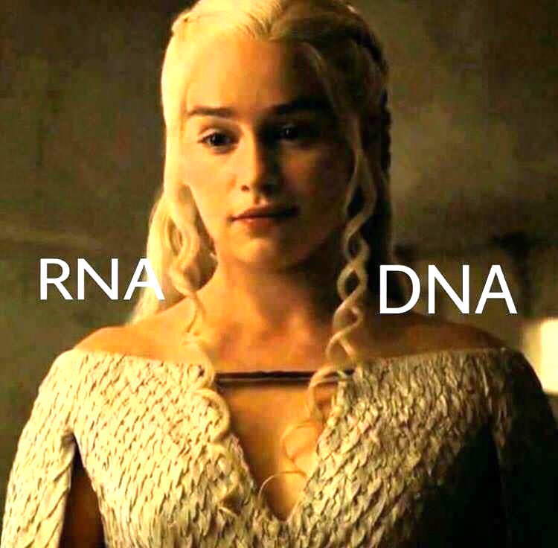
DNA
Cryptography
-With One Time Pad
Team Name : RNA
109550096 杜峯
109550161 古聖聰
109550014 黃姿淯
109550130 林念慈

Slide 2
What we will do…
ONE-TIME PAD
PLAINTEXT
1
2
COMPUTATION
CIPHERTEXT
3
4
Use PRNG to generate a one-time password
Transform our plaintext
Implement the computation on the plaintext
Output the ciphertext as a DNA message

Slide 3
1
ONE-TIME PAD

Slide 4
—by LFSR
Generate a sequence of ‘0’ and ‘1’ key with LFSR.

Slide 5
2
PLAINTEXT

Slide 6
PLAINTEXT
ASCII
‘0’ OR ‘1’
NEW INFO
Transform the plaintext to ASCII code.
Make the ASCII as ‘0’ or ‘1’ binary code.
Go to next step.

Slide 7
3
COMPUTATION

Slide 8
XOR operation
0 xor 0 = 0
0 xor 1 = 1
1 xor 0 = 1
1 xor 1 = 0

Slide 9
4
CIPHERTEXT

Slide 10
DNA-DESIGN STRUKTUR
MAP
CIPHERTEXT
MAP the sequence to
‘A’ ‘T’ ‘C’ ‘G’
We will get a ciphertext like a DNA message.

Slide 11
DNA-MAPPING
A
T
C
G
01
10
11
00

Slide 12
ADVANTAGE
No consumption of electricity
Store with DNA architecture
Deal with massive data at once (parallel)

